Slide 1
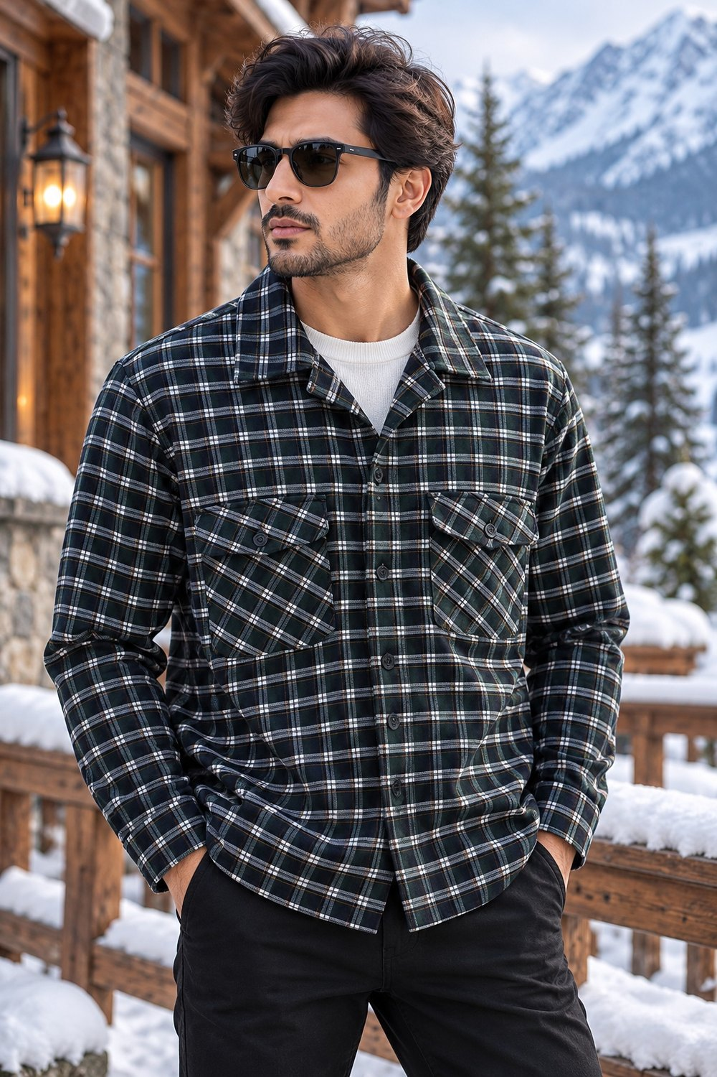
MENSWEAR PRODUCT QTY SHEET | STYLE 001
STYLE DETAILS
STYLE NO.
ODM/260610/0118 MID BLUE
SIZE-WISE QUANTITY (PCS)
SIZE | QTY (PCS)
XS
S
M
L
XL
XXL
TOTAL PCS
Image reference: 6B7DBD60-070C-4D32-9921-3409D362ED5E.jpeg • Enter style number and quantities in the blank fields

Slide 2
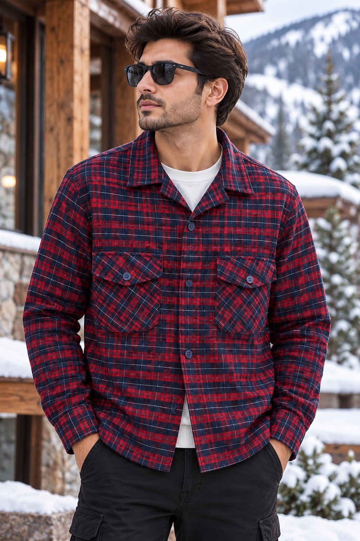
MENSWEAR PRODUCT QTY SHEET | STYLE 002
STYLE DETAILS
STYLE NO.
ODM/260610/0118 MAROON
SIZE-WISE QUANTITY (PCS)
SIZE | QTY (PCS)
XS
S
M
L
XL
XXL
TOTAL PCS
Image reference: D880041F-6B6F-43B4-929E-2029C9631654.jpeg • Enter style number and quantities in the blank fields

Slide 3
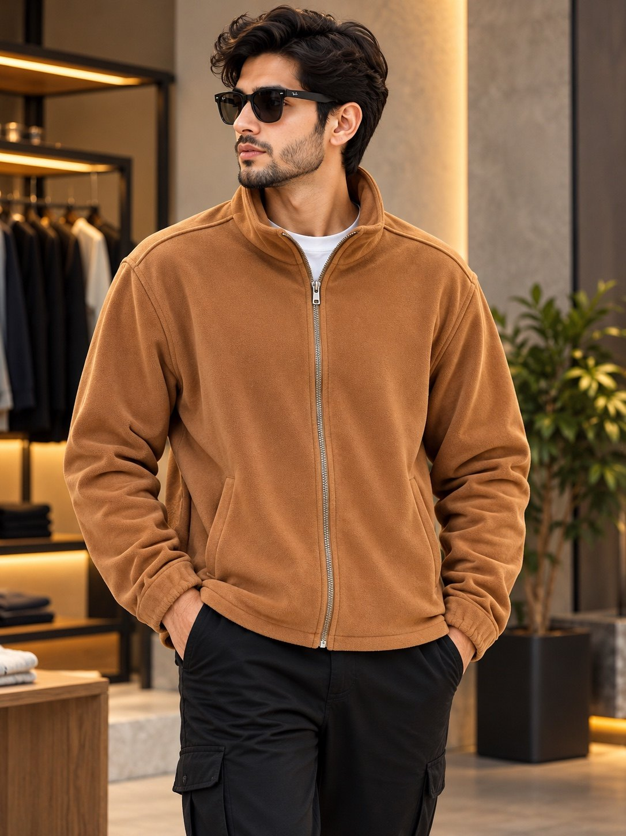
MENSWEAR PRODUCT QTY SHEET | STYLE 002
STYLE DETAILS
STYLE NO.
ODM/260610/0075 TAN
SIZE-WISE QUANTITY (PCS)
SIZE | QTY (PCS)
XS
S
M
L
XL
XXL
TOTAL PCS
Image reference: D880041F-6B6F-43B4-929E-2029C9631654.jpeg • Enter style number and quantities in the blank fields

Slide 4
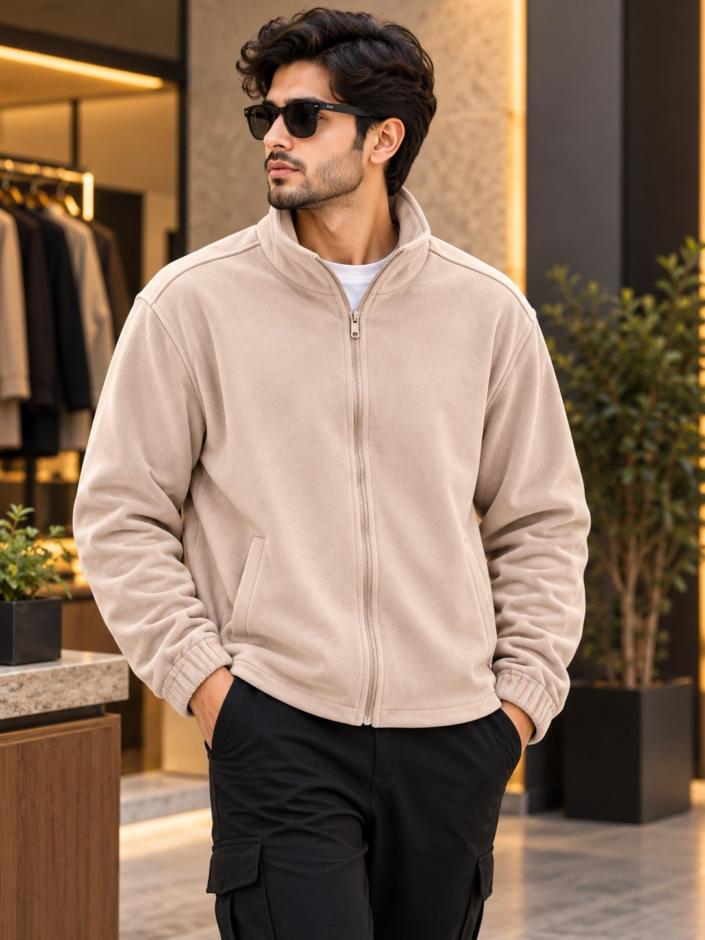
MENSWEAR PRODUCT QTY SHEET | STYLE 002
STYLE DETAILS
STYLE NO.
ODM/260610/0075 CAMEL
SIZE-WISE QUANTITY (PCS)
SIZE | QTY (PCS)
XS
S
M
L
XL
XXL
TOTAL PCS
Image reference: D880041F-6B6F-43B4-929E-2029C9631654.jpeg • Enter style number and quantities in the blank fields

Slide 5
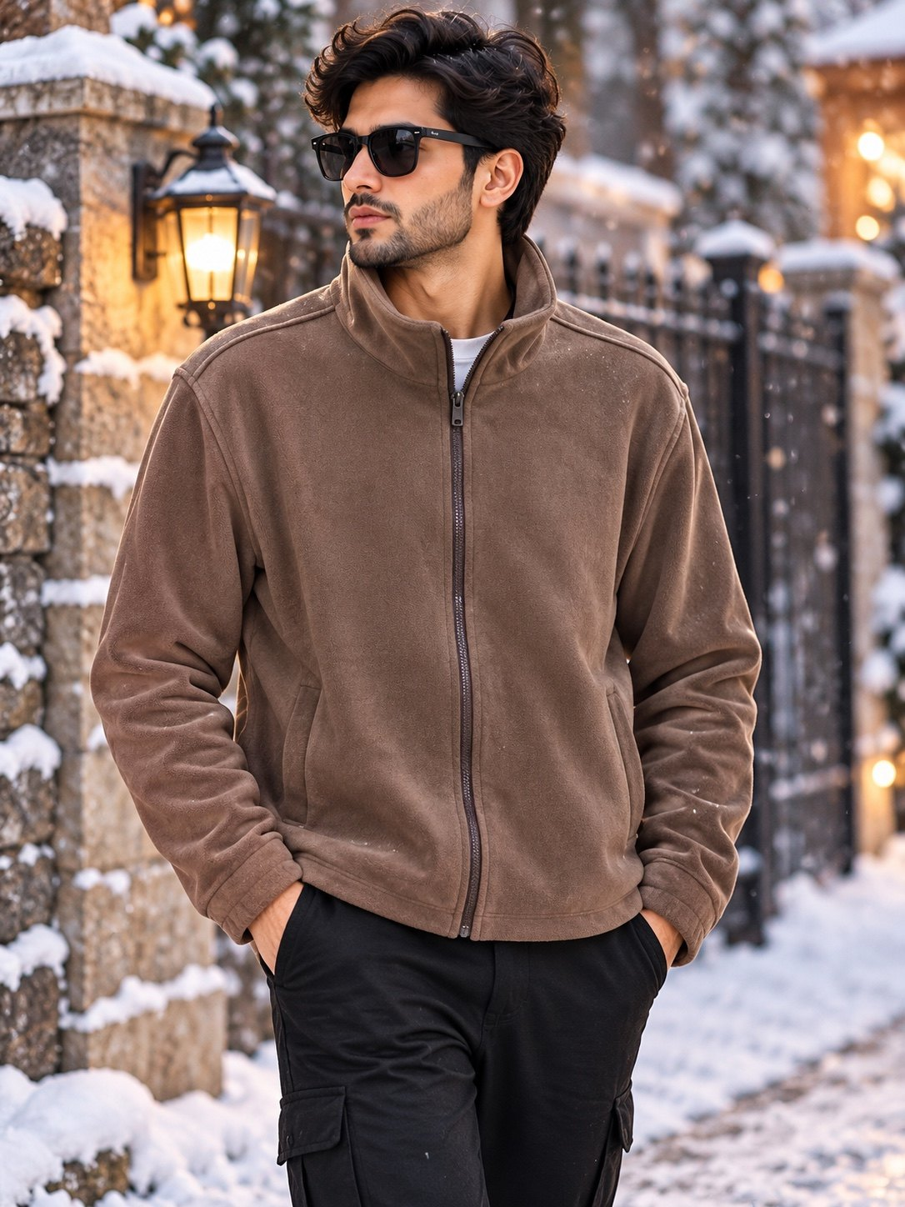
MENSWEAR PRODUCT QTY SHEET | STYLE 002
STYLE DETAILS
STYLE NO.
ODM/260610/0075 COFFEE
SIZE-WISE QUANTITY (PCS)
SIZE | QTY (PCS)
XS
S
M
L
XL
XXL
TOTAL PCS
Image reference: D880041F-6B6F-43B4-929E-2029C9631654.jpeg • Enter style number and quantities in the blank fields

Slide 6
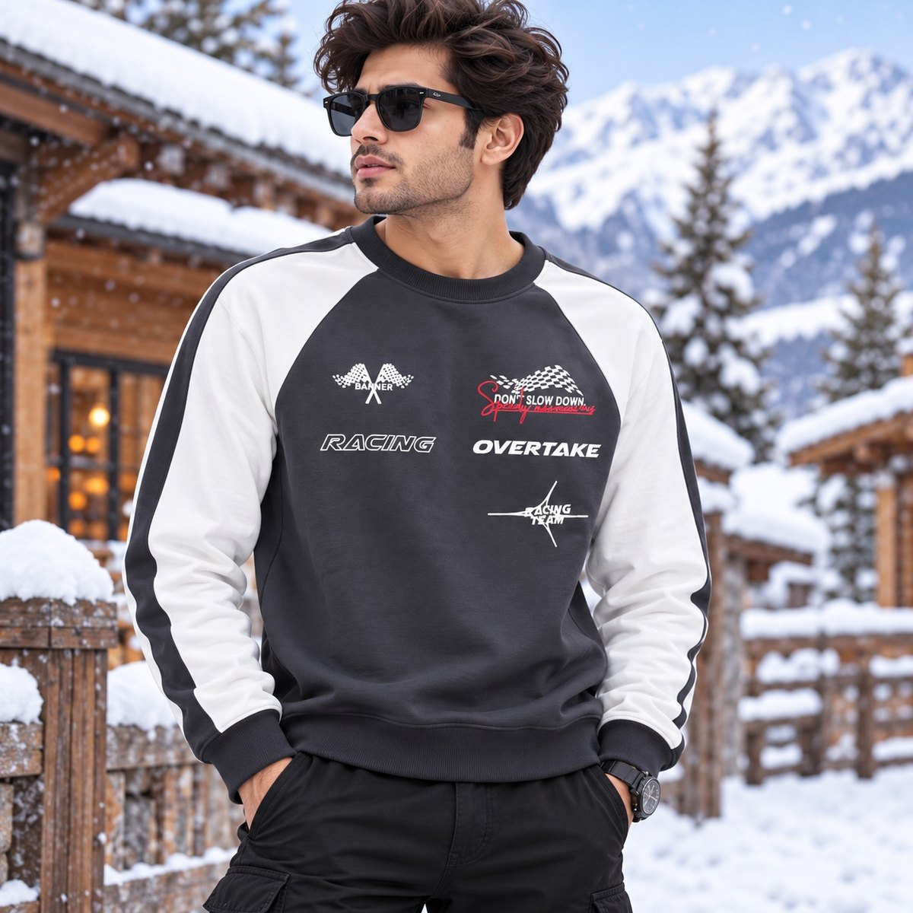
MENSWEAR PRODUCT QTY SHEET | STYLE 003
STYLE DETAILS
STYLE NO.
OEM/260430/0086 GREY
SIZE-WISE QUANTITY (PCS)
SIZE | QTY (PCS)
XS
S
M
L
XL
XXL
TOTAL PCS
Image reference: 4D63705A-139C-4355-AE39-7F59319E8724(2).jpeg • Enter style number and quantities in the blank fields

Slide 7
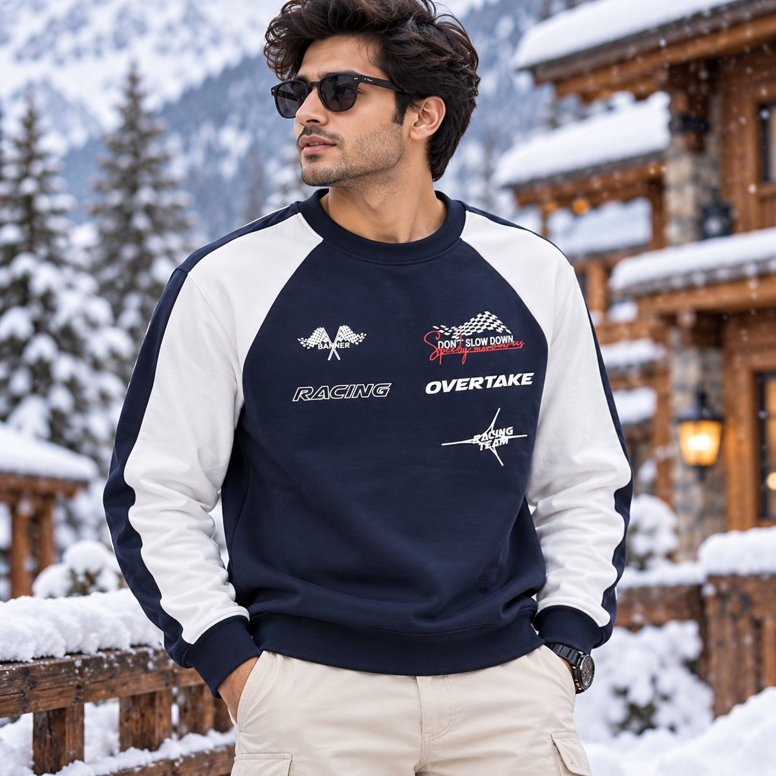
MENSWEAR PRODUCT QTY SHEET | STYLE 003
STYLE DETAILS
STYLE NO.
OEM/260430/0086 NAVY
SIZE-WISE QUANTITY (PCS)
SIZE | QTY (PCS)
XS
S
M
L
XL
XXL
TOTAL PCS
Image reference: 4D63705A-139C-4355-AE39-7F59319E8724(2).jpeg • Enter style number and quantities in the blank fields

Slide 8
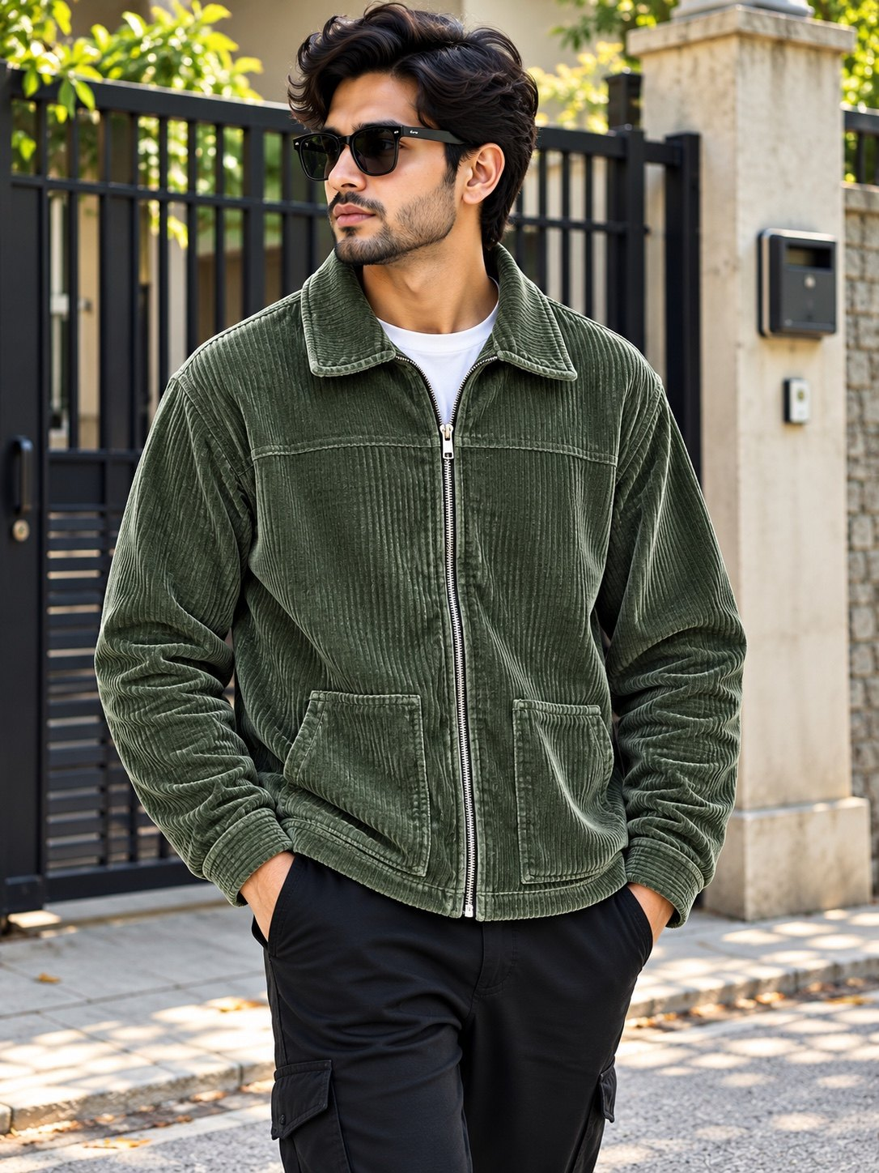
MENSWEAR PRODUCT QTY SHEET | STYLE 004
STYLE DETAILS
STYLE NO.
ODM/260423/0018 OLIVE
SIZE-WISE QUANTITY (PCS)
SIZE | QTY (PCS)
XS
S
M
L
XL
XXL
TOTAL PCS
Image reference: 5E090138-5CCA-44B0-A476-0AB5A7BA85BF.jpeg • Enter style number and quantities in the blank fields

Slide 9
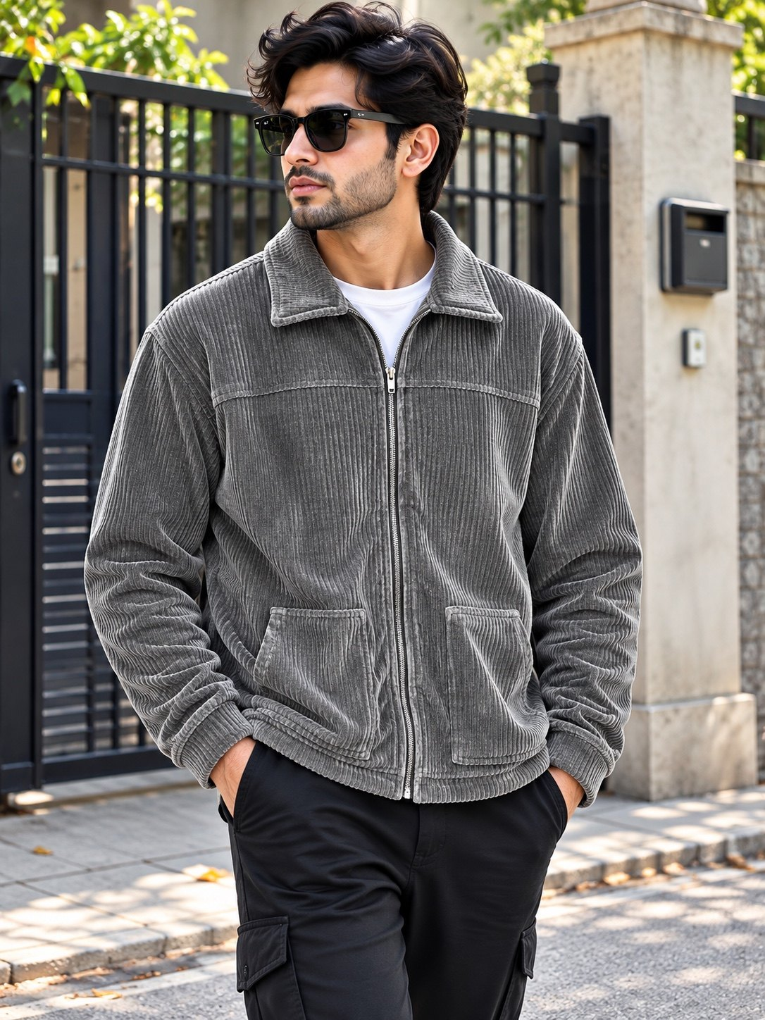
MENSWEAR PRODUCT QTY SHEET | STYLE 008
STYLE DETAILS
STYLE NO.
ODM/260423/0018 GREY
SIZE-WISE QUANTITY (PCS)
SIZE | QTY (PCS)
XS
S
M
L
XL
XXL
TOTAL PCS
Image reference: 1B58736B-4193-47B8-B374-74463BB00923.jpeg • Enter style number and quantities in the blank fields

Slide 10
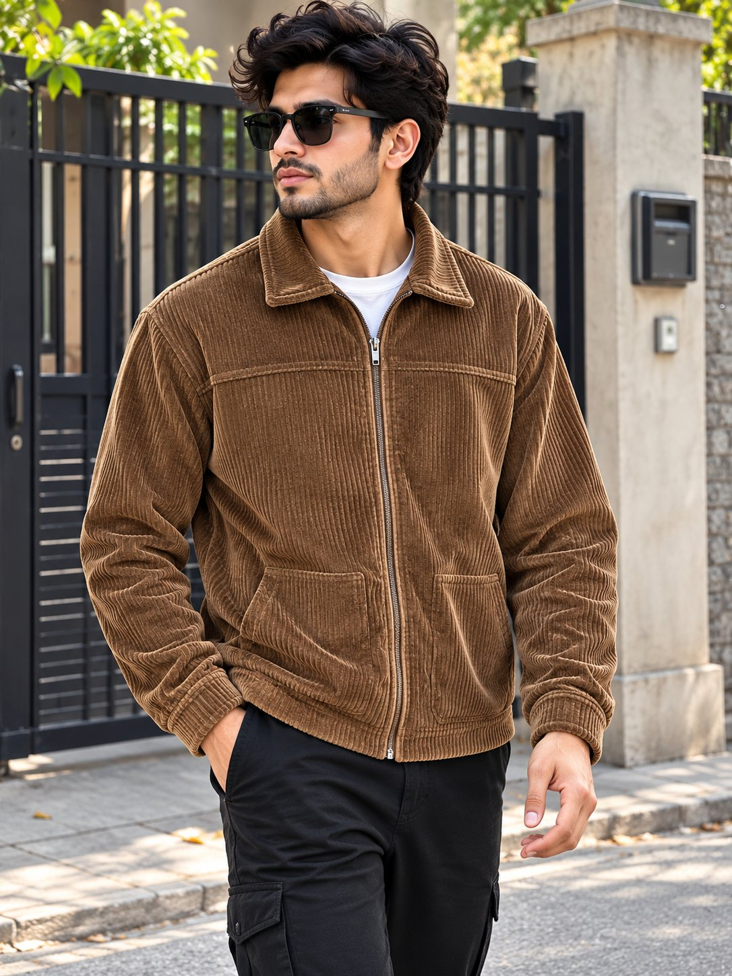
MENSWEAR PRODUCT QTY SHEET | STYLE 009
STYLE DETAILS
STYLE NO.
ODM/260423/0018 TAN
SIZE-WISE QUANTITY (PCS)
SIZE | QTY (PCS)
XS
S
M
L
XL
XXL
TOTAL PCS
Image reference: A1D0ECEF-7F9B-4E23-A591-0D68E3A2CBDD.jpeg • Enter style number and quantities in the blank fields

Slide 11
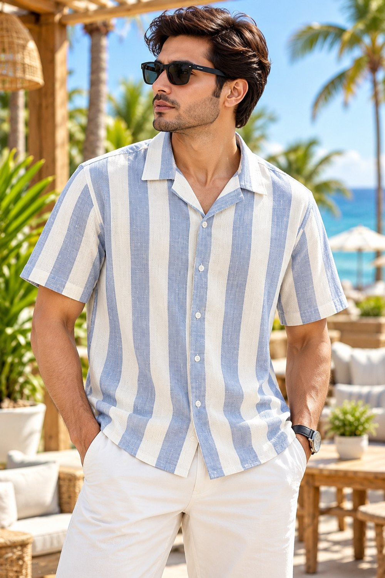
MENSWEAR PRODUCT QTY SHEET | STYLE 012
STYLE DETAILS
STYLE NO.
ODM/260404/0005 BLUE
SIZE-WISE QUANTITY (PCS)
SIZE | QTY (PCS)
XS
S
M
L
XL
XXL
TOTAL PCS
Image reference: 22436535-F120-4E73-9778-AA90BD6BB752.jpeg • Enter style number and quantities in the blank fields

Slide 12
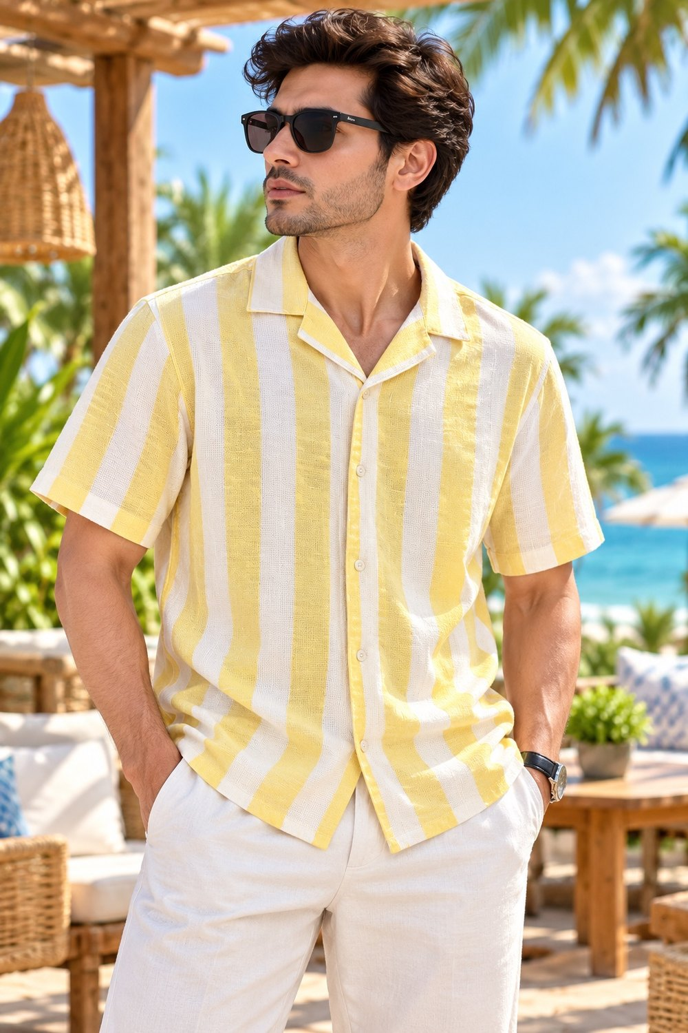
MENSWEAR PRODUCT QTY SHEET | STYLE 013
STYLE DETAILS
STYLE NO.
ODM/260404/0005 YELLOW
SIZE-WISE QUANTITY (PCS)
SIZE | QTY (PCS)
XS
S
M
L
XL
XXL
TOTAL PCS
Image reference: 7EB83252-F1F0-40DD-9DC4-202201CF61FB.jpeg • Enter style number and quantities in the blank fields

Slide 13
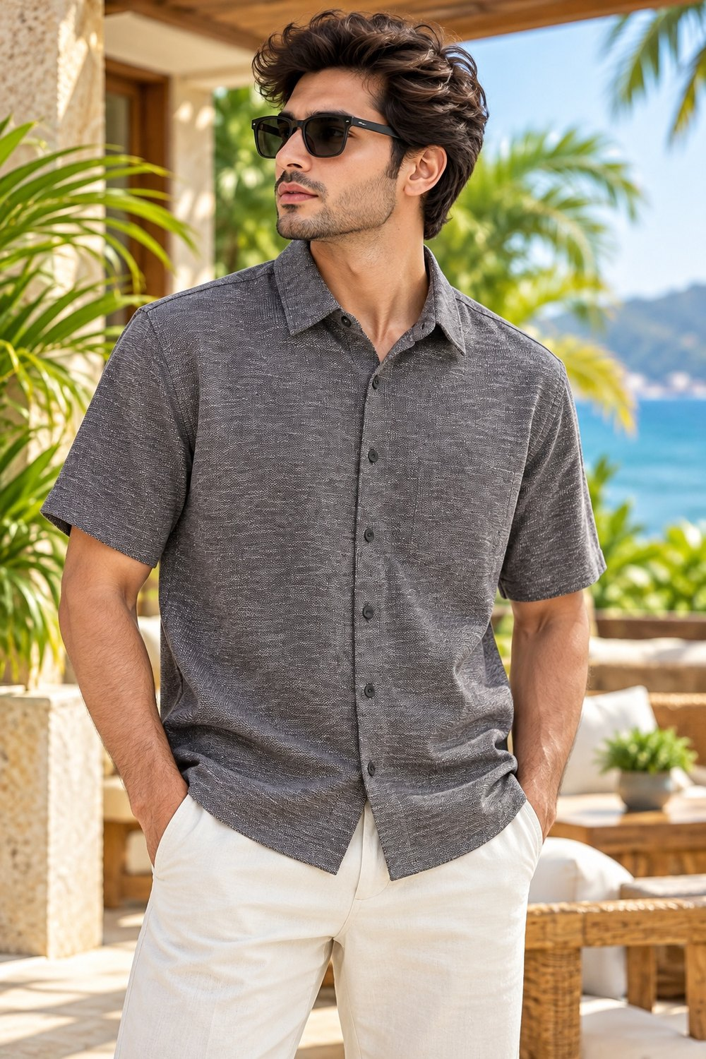
MENSWEAR PRODUCT QTY SHEET | STYLE 017
STYLE DETAILS
STYLE NO.
ODM/260602/0026 BLACK
SIZE-WISE QUANTITY (PCS)
SIZE | QTY (PCS)
XS
S
M
L
XL
XXL
TOTAL PCS
Image reference: E0CB1E22-E2F9-4EA1-86F5-60EEE0C7D4A2.jpeg • Enter style number and quantities in the blank fields

Slide 14
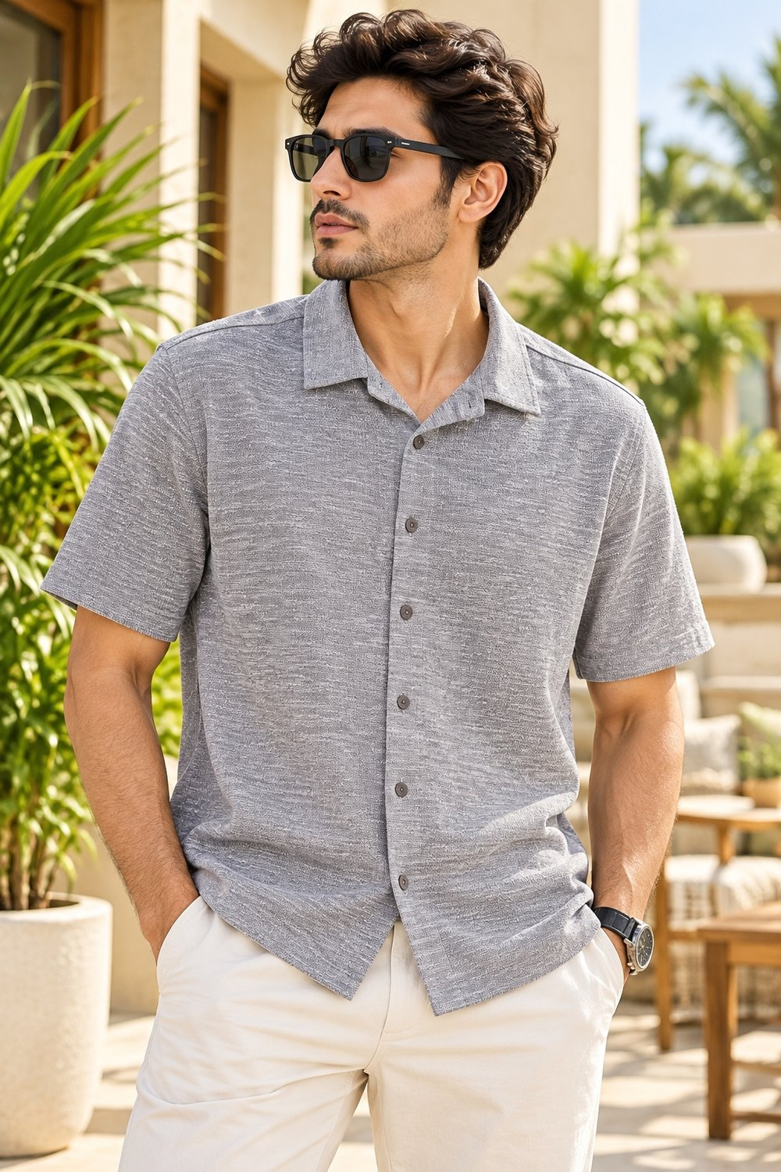
MENSWEAR PRODUCT QTY SHEET | STYLE 021
STYLE DETAILS
STYLE NO.
ODM/260602/0026 GREY
SIZE-WISE QUANTITY (PCS)
SIZE | QTY (PCS)
XS
S
M
L
XL
XXL
TOTAL PCS
Image reference: EEE8026F-F0BA-4A65-B213-7B53C6B402F7.jpeg • Enter style number and quantities in the blank fields

Slide 15
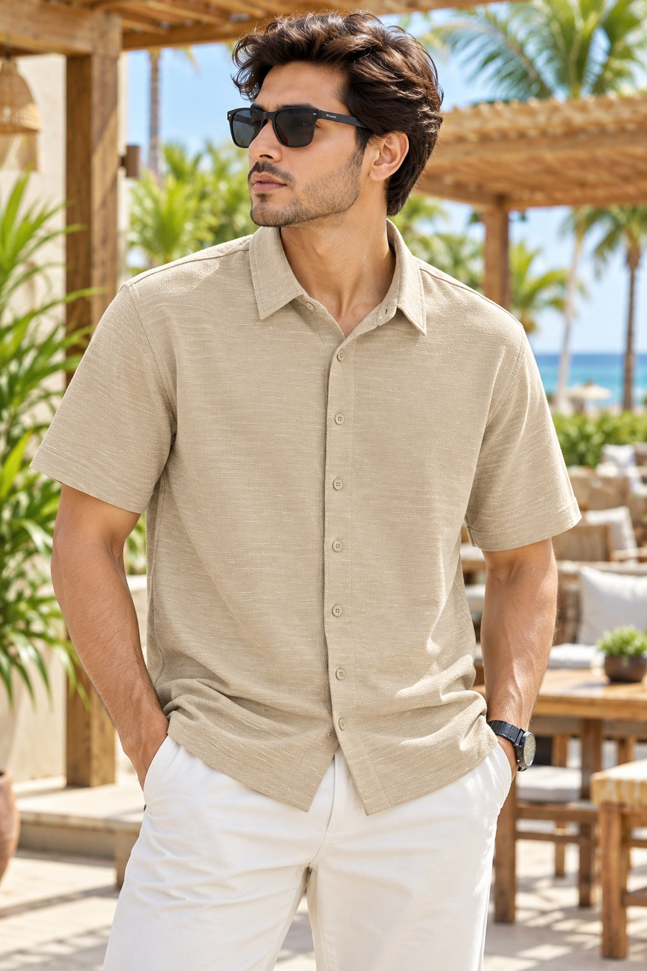
MENSWEAR PRODUCT QTY SHEET | STYLE 021
STYLE DETAILS
STYLE NO.
ODM/260602/0026 BEIGE
SIZE-WISE QUANTITY (PCS)
SIZE | QTY (PCS)
XS
S
M
L
XL
XXL
TOTAL PCS
Image reference: EEE8026F-F0BA-4A65-B213-7B53C6B402F7.jpeg • Enter style number and quantities in the blank fields

Slide 16
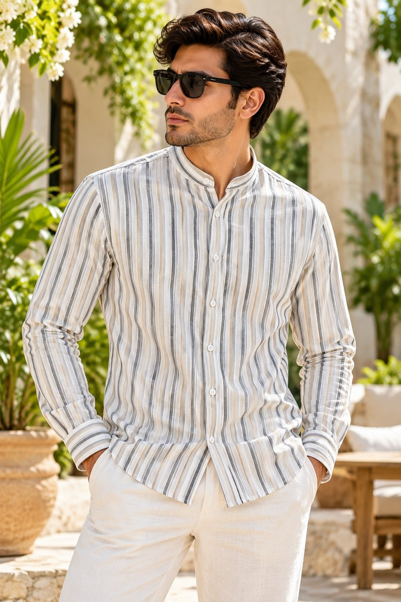
MENSWEAR PRODUCT QTY SHEET | STYLE 022
STYLE DETAILS
STYLE NO.
ODM/260404/0001 BEIGE
SIZE-WISE QUANTITY (PCS)
SIZE | QTY (PCS)
XS
S
M
L
XL
XXL
TOTAL PCS
Image reference: CCD751A9-C941-4235-9CD2-2F7F0123AF8E(1).jpeg • Enter style number and quantities in the blank fields

Slide 17
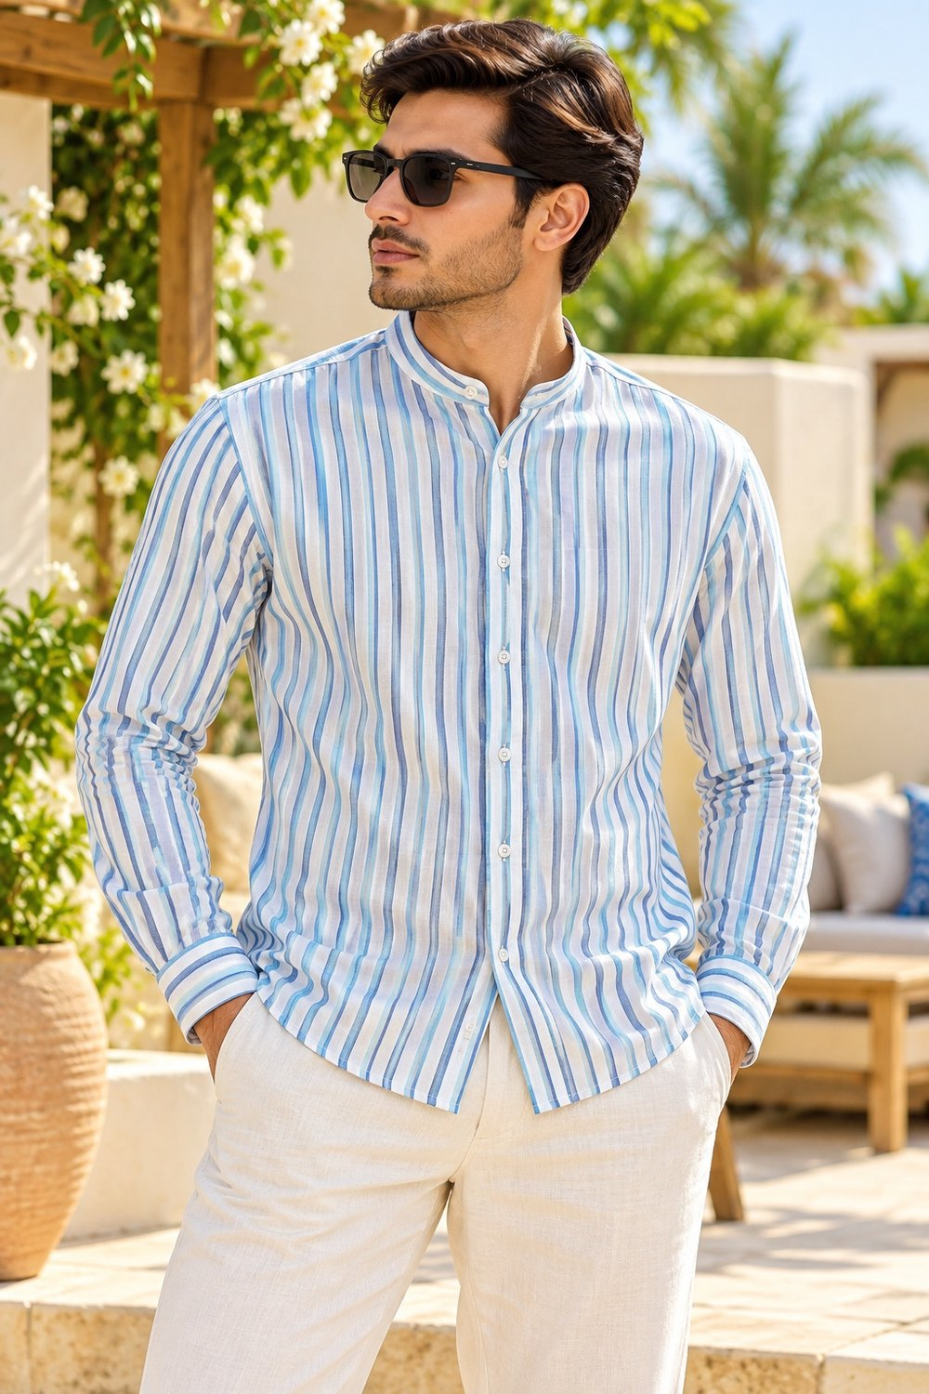
MENSWEAR PRODUCT QTY SHEET | STYLE 023
STYLE DETAILS
STYLE NO.
ODM/260404/0001 BLUE
SIZE-WISE QUANTITY (PCS)
SIZE | QTY (PCS)
XS
S
M
L
XL
XXL
TOTAL PCS
Image reference: A8FB17DD-D248-4ECE-9963-89C242A4EA73.jpeg • Enter style number and quantities in the blank fields

Slide 18
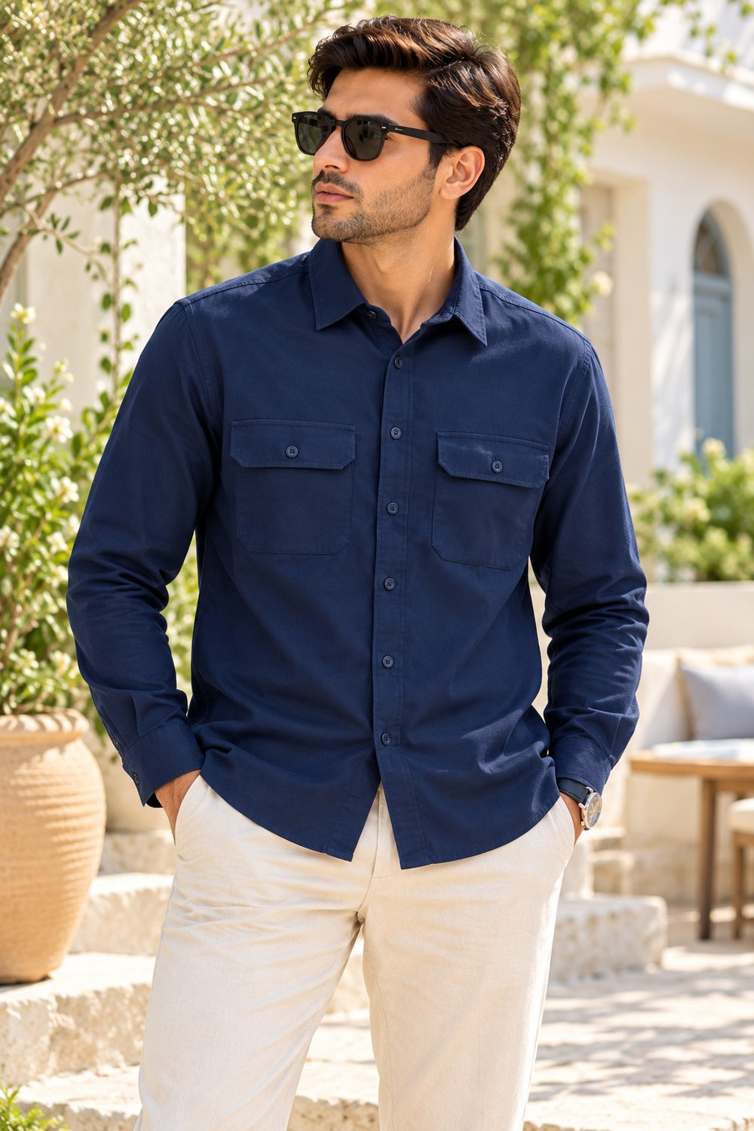
MENSWEAR PRODUCT QTY SHEET | STYLE 025
STYLE DETAILS
STYLE NO.
ODM/260528/0042 NAVY BLUE
SIZE-WISE QUANTITY (PCS)
SIZE | QTY (PCS)
XS
S
M
L
XL
XXL
TOTAL PCS
Image reference: a_bright_sunlit_outdoor_fashion_portrait_scene_a.png • Enter style number and quantities in the blank fields

Slide 19
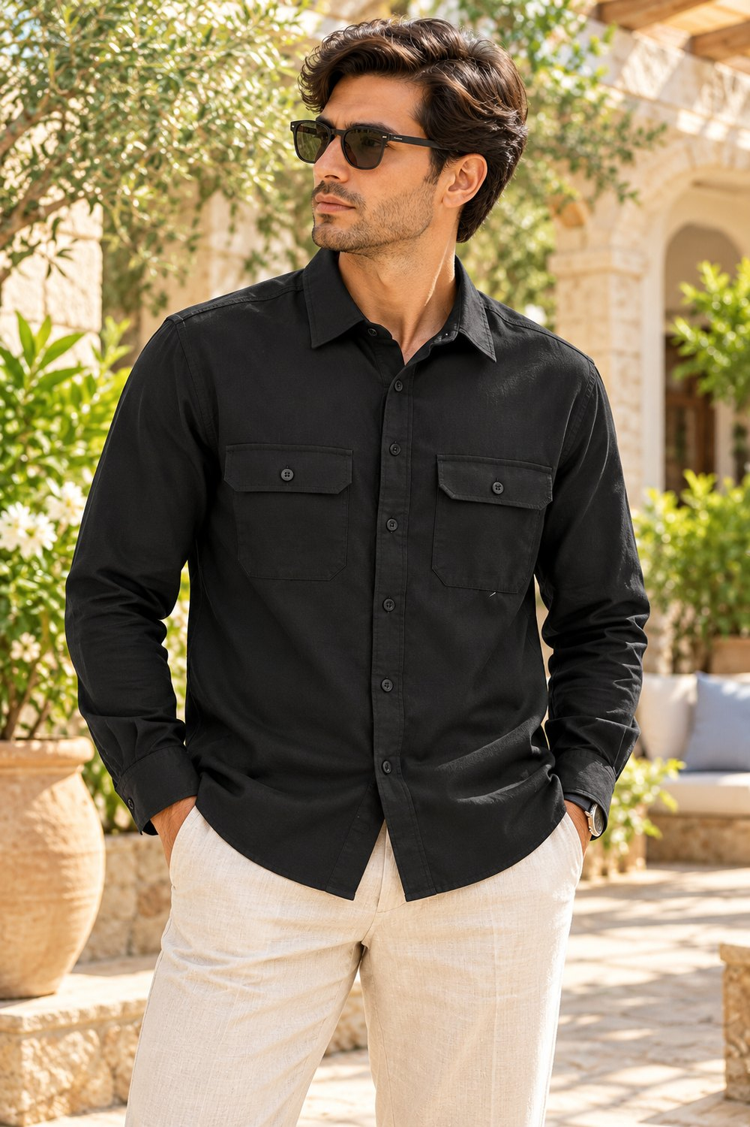
MENSWEAR PRODUCT QTY SHEET | STYLE 026
STYLE DETAILS
STYLE NO.
ODM/260528/0042 BLACK
SIZE-WISE QUANTITY (PCS)
SIZE | QTY (PCS)
XS
S
M
L
XL
XXL
TOTAL PCS
Image reference: outdoor_sunlit_lifestyle_fashion_portrait_scene_a.png • Enter style number and quantities in the blank fields

Slide 20
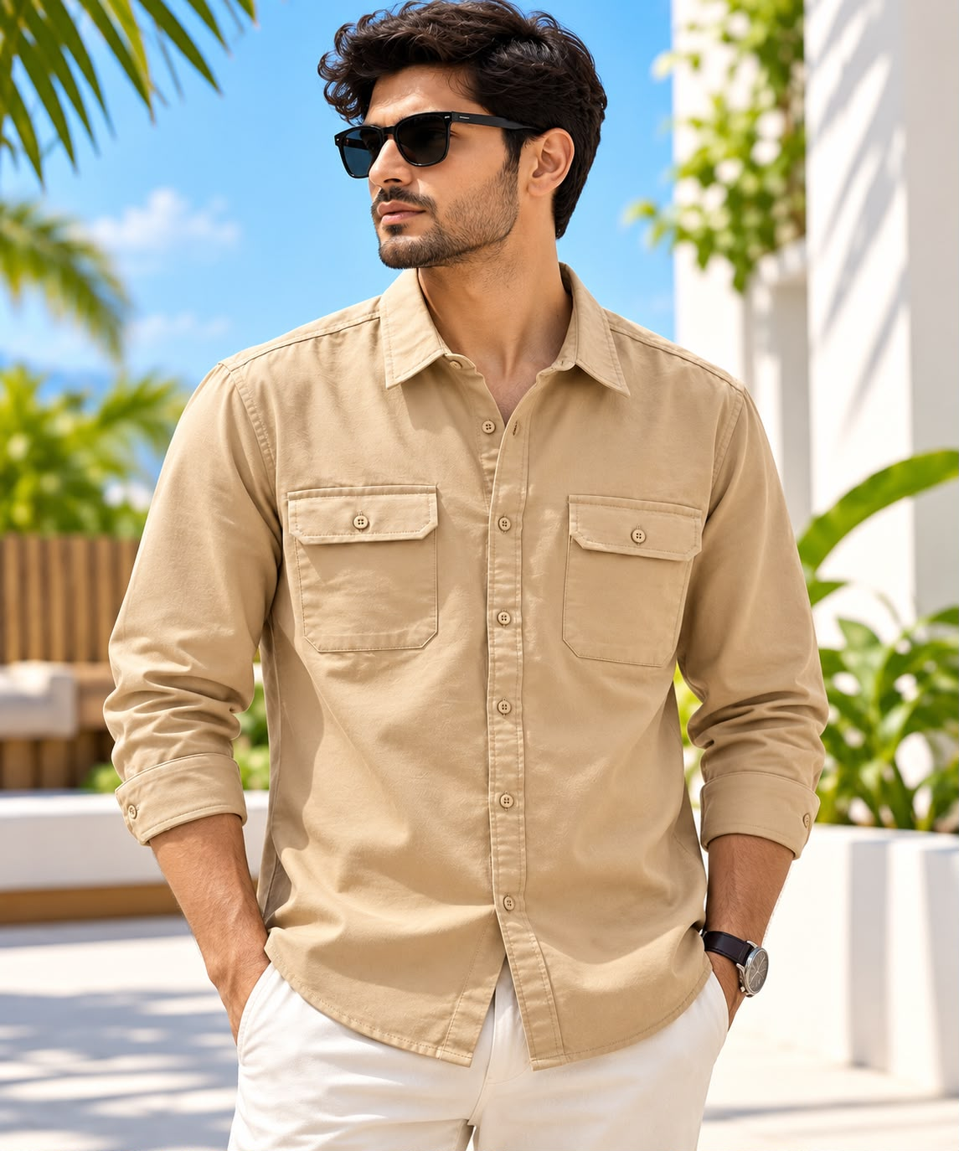
MENSWEAR PRODUCT QTY SHEET | STYLE 027
STYLE DETAILS
STYLE NO.
ODM/260528/0042 BEIGE
SIZE-WISE QUANTITY (PCS)
SIZE | QTY (PCS)
XS
S
M
L
XL
XXL
TOTAL PCS
Image reference: 5ADBBD2C-6941-48A0-B61A-FB74B02A9206.jpeg • Enter style number and quantities in the blank fields

Slide 21
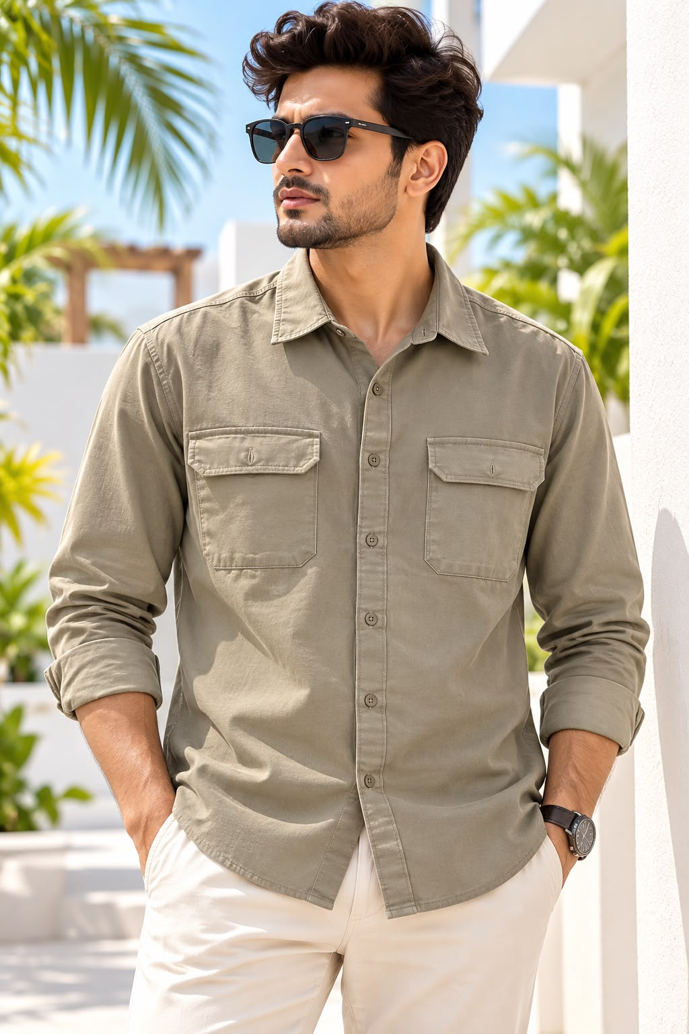
MENSWEAR PRODUCT QTY SHEET | STYLE 027
STYLE DETAILS
STYLE NO.
ODM/260528/0042 KHAKI
SIZE-WISE QUANTITY (PCS)
SIZE | QTY (PCS)
XS
S
M
L
XL
XXL
TOTAL PCS
Image reference: 5ADBBD2C-6941-48A0-B61A-FB74B02A9206.jpeg • Enter style number and quantities in the blank fields

Slide 22
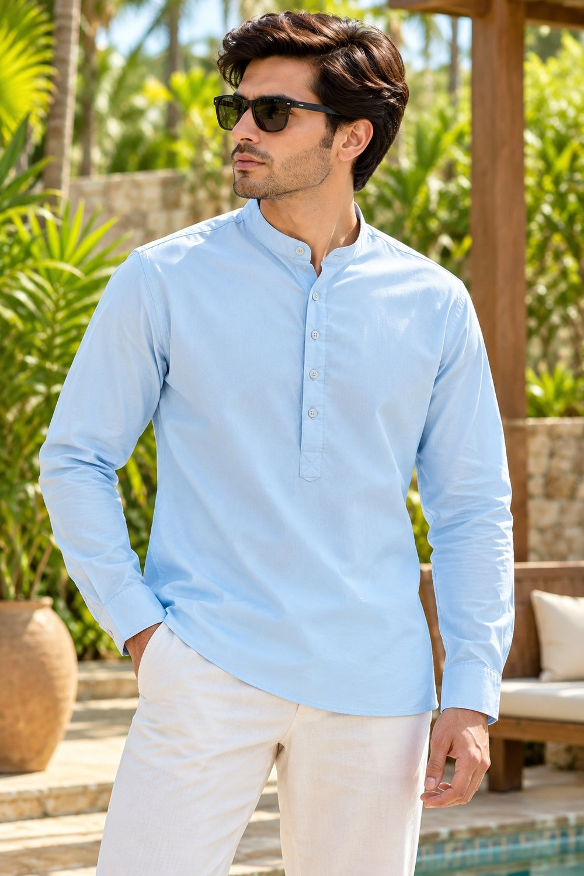
MENSWEAR PRODUCT QTY SHEET | STYLE 031
STYLE DETAILS
STYLE NO.
ODM/260530/0055 SKY BLUE
SIZE-WISE QUANTITY (PCS)
SIZE | QTY (PCS)
XS
S
M
L
XL
XXL
TOTAL PCS
Image reference: 4ACEF02A-304B-4251-AD39-CAD0D2EC6999.jpeg • Enter style number and quantities in the blank fields

Slide 23
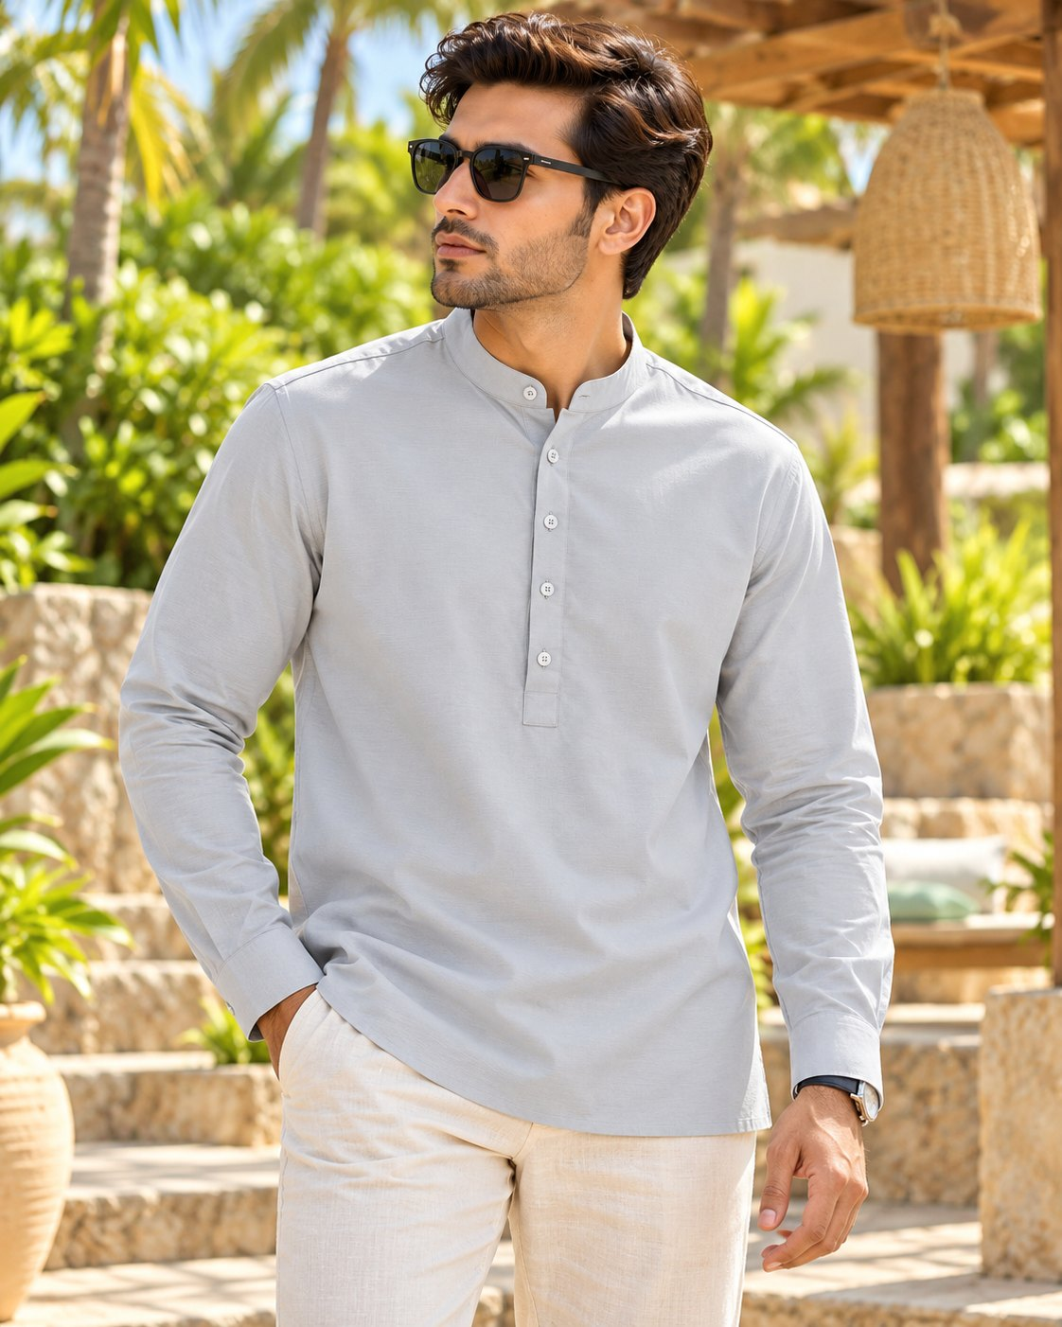
MENSWEAR PRODUCT QTY SHEET | STYLE 032
STYLE DETAILS
STYLE NO.
ODM/260530/0055 LT GREY
SIZE-WISE QUANTITY (PCS)
SIZE | QTY (PCS)
XS
S
M
L
XL
XXL
TOTAL PCS
Image reference: outdoor_fashion_portrait_scene_in_bright_sunlight.png • Enter style number and quantities in the blank fields

Slide 24
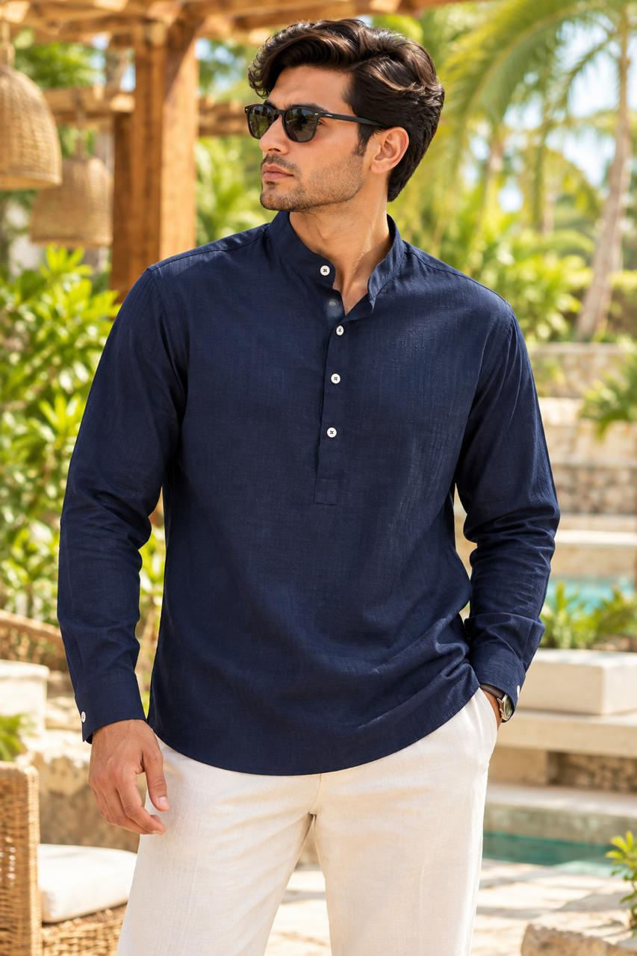
MENSWEAR PRODUCT QTY SHEET | STYLE 032
STYLE DETAILS
STYLE NO.
ODM/260530/0055 NAVY BLUE
SIZE-WISE QUANTITY (PCS)
SIZE | QTY (PCS)
XS
S
M
L
XL
XXL
TOTAL PCS
Image reference: outdoor_fashion_portrait_scene_in_bright_sunlight.png • Enter style number and quantities in the blank fields

Slide 25
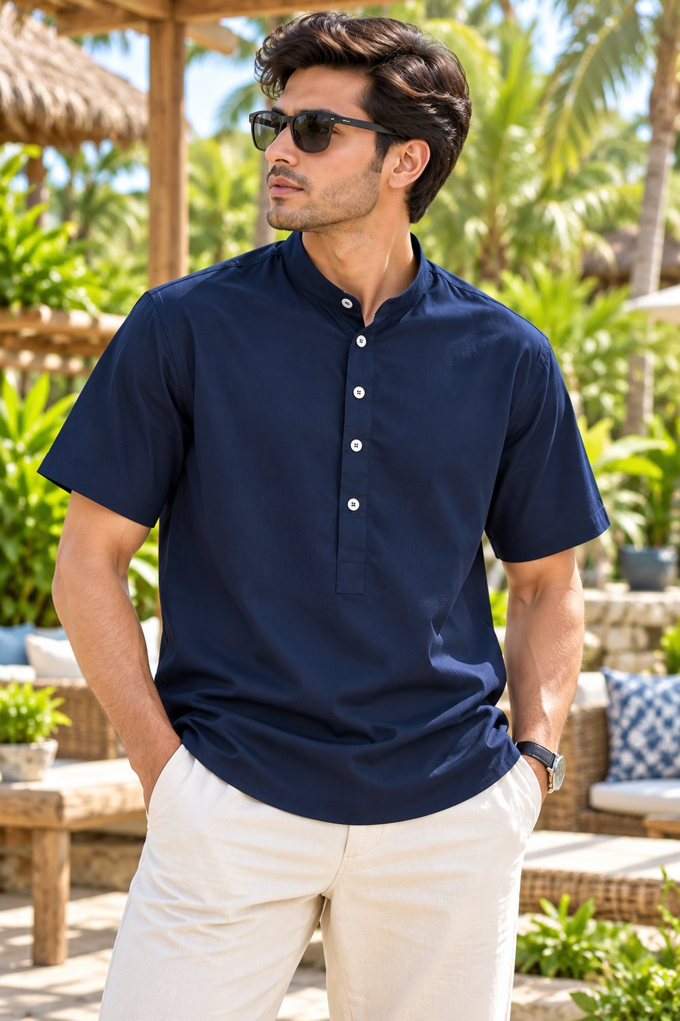
MENSWEAR PRODUCT QTY SHEET | STYLE 040
STYLE DETAILS
STYLE NO.
ODM/260529/0147 NAVY BLUE
SIZE-WISE QUANTITY (PCS)
SIZE | QTY (PCS)
XS
S
M
L
XL
XXL
TOTAL PCS
Image reference: a_crisp_high_resolution_outdoor_lifestyle_portrai.png • Enter style number and quantities in the blank fields

Slide 26
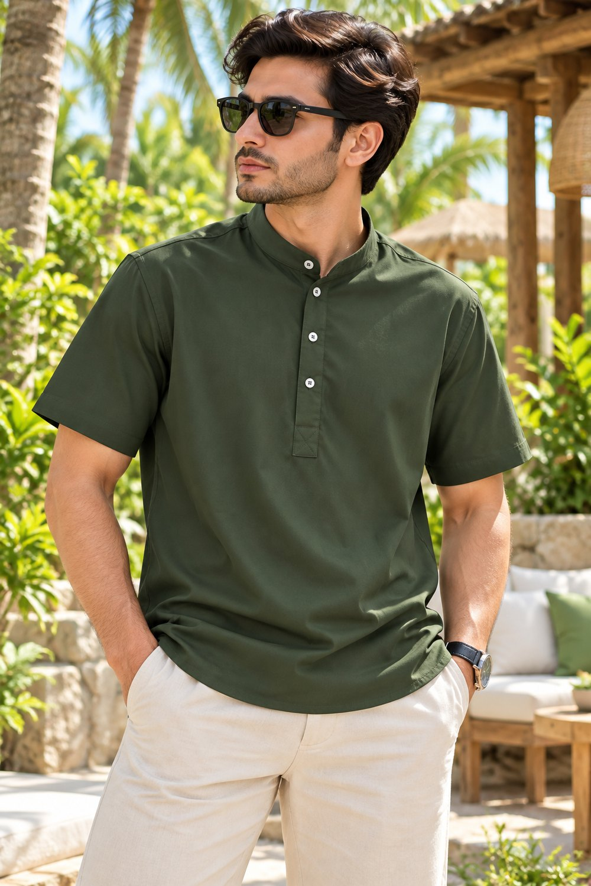
MENSWEAR PRODUCT QTY SHEET | STYLE 046
STYLE DETAILS
STYLE NO.
ODM/260529/0147 OLIVE
SIZE-WISE QUANTITY (PCS)
SIZE | QTY (PCS)
XS
S
M
L
XL
XXL
TOTAL PCS
Image reference: outdoor_tropical_resort_style_portrait_scene_a_we.png • Enter style number and quantities in the blank fields

Slide 27
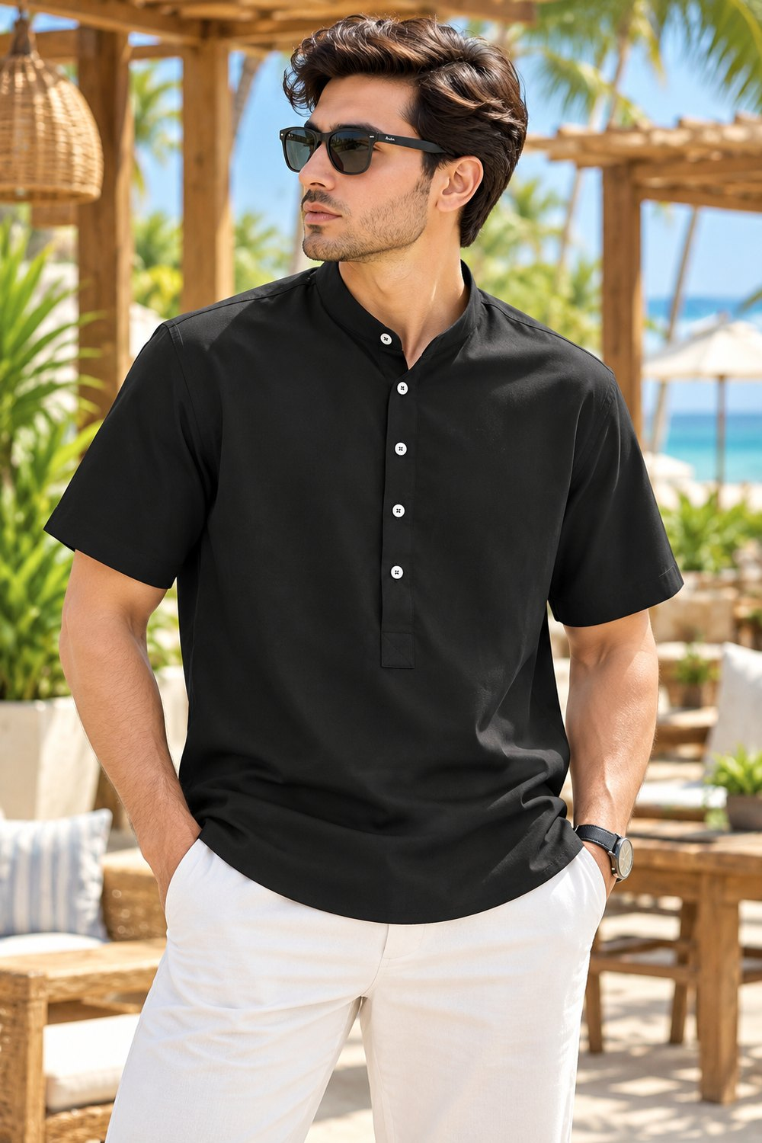
MENSWEAR PRODUCT QTY SHEET | STYLE 047
STYLE DETAILS
STYLE NO.
ODM/260529/0147 BLACK
SIZE-WISE QUANTITY (PCS)
SIZE | QTY (PCS)
XS
S
M
L
XL
XXL
TOTAL PCS
Image reference: outdoor_beach_resort_style_portrait_scene_bright.png • Enter style number and quantities in the blank fields

Slide 28
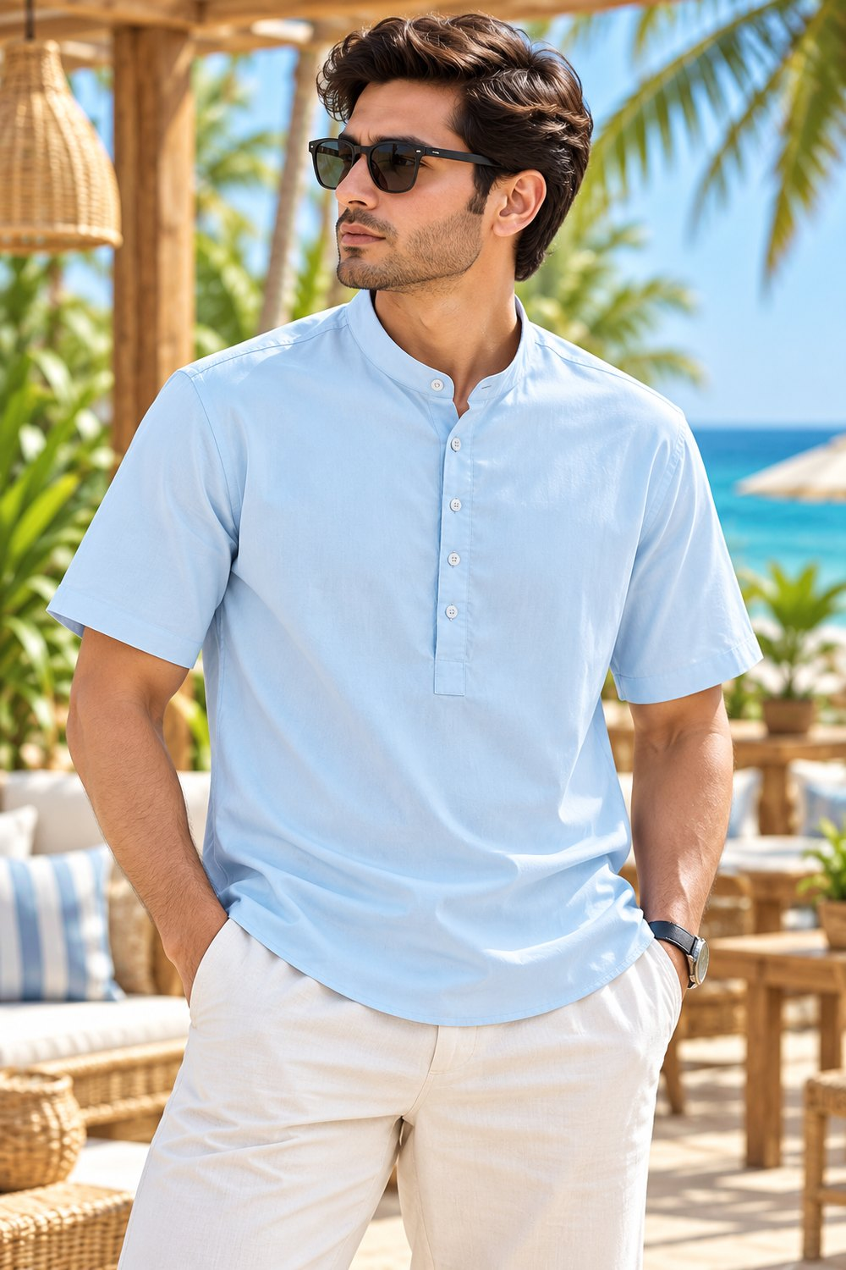
MENSWEAR PRODUCT QTY SHEET | STYLE 049
STYLE DETAILS
STYLE NO.
ODM/260529/0147 SKY BLUE
SIZE-WISE QUANTITY (PCS)
SIZE | QTY (PCS)
XS
S
M
L
XL
XXL
TOTAL PCS
Image reference: a_crisp_high_resolution_outdoor_beach_resort_styl.png • Enter style number and quantities in the blank fields

Slide 29
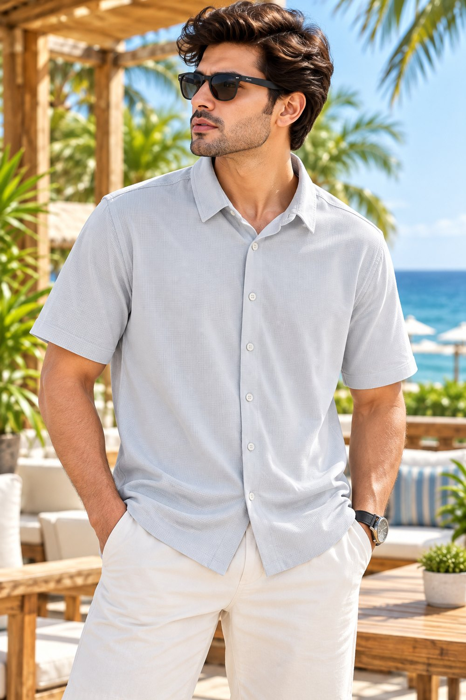
MENSWEAR PRODUCT QTY SHEET | STYLE 054
STYLE DETAILS
STYLE NO.
ODM/260601/0021 LT GREY
SIZE-WISE QUANTITY (PCS)
SIZE | QTY (PCS)
XS
S
M
L
XL
XXL
TOTAL PCS
Image reference: outdoor_beachside_resort_terrace_scene_in_bright_d.png • Enter style number and quantities in the blank fields

Slide 30
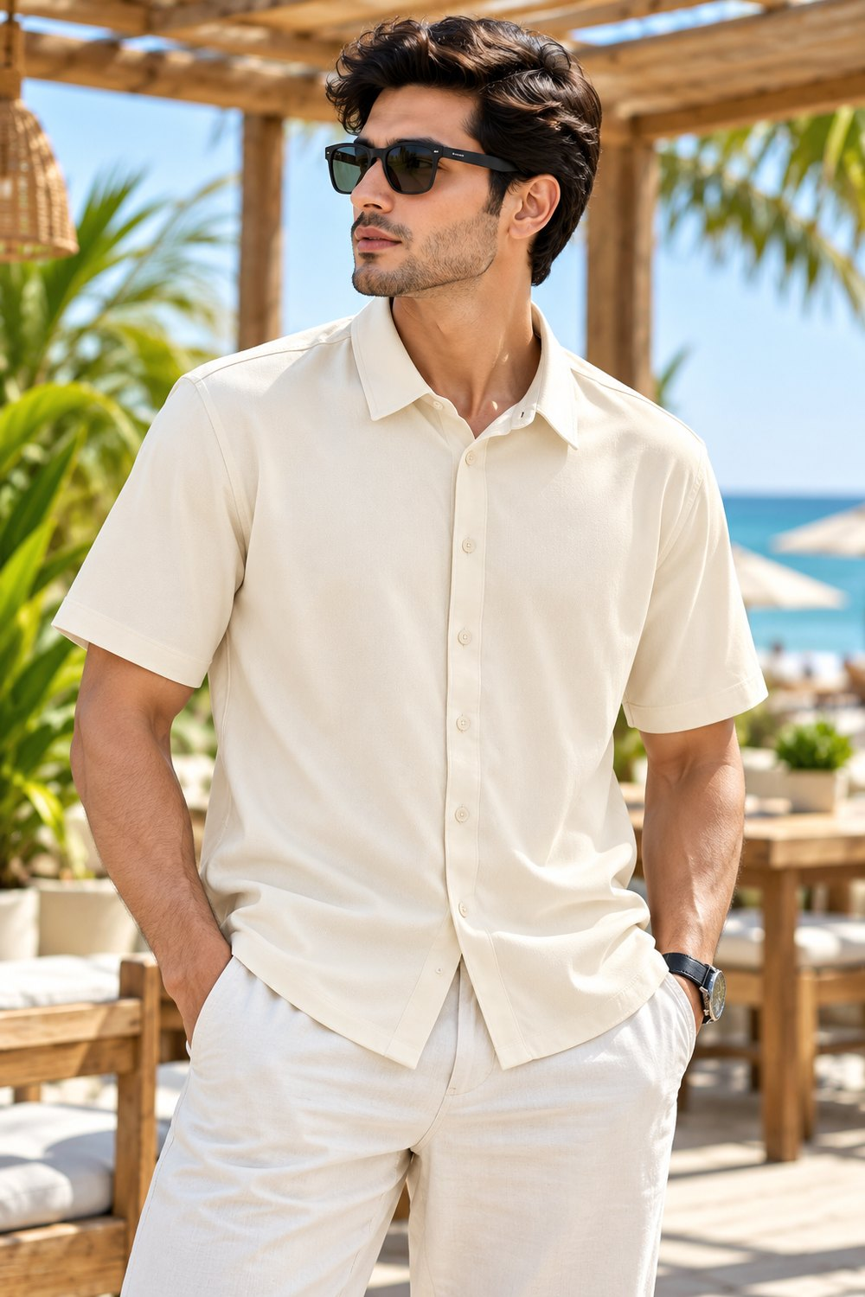
MENSWEAR PRODUCT QTY SHEET | STYLE 055
STYLE DETAILS
STYLE NO.
ODM/260601/0021 CREAM
SIZE-WISE QUANTITY (PCS)
SIZE | QTY (PCS)
XS
S
M
L
XL
XXL
TOTAL PCS
Image reference: outdoor_tropical_beach_resort_lifestyle_portrait.png • Enter style number and quantities in the blank fields

Slide 31
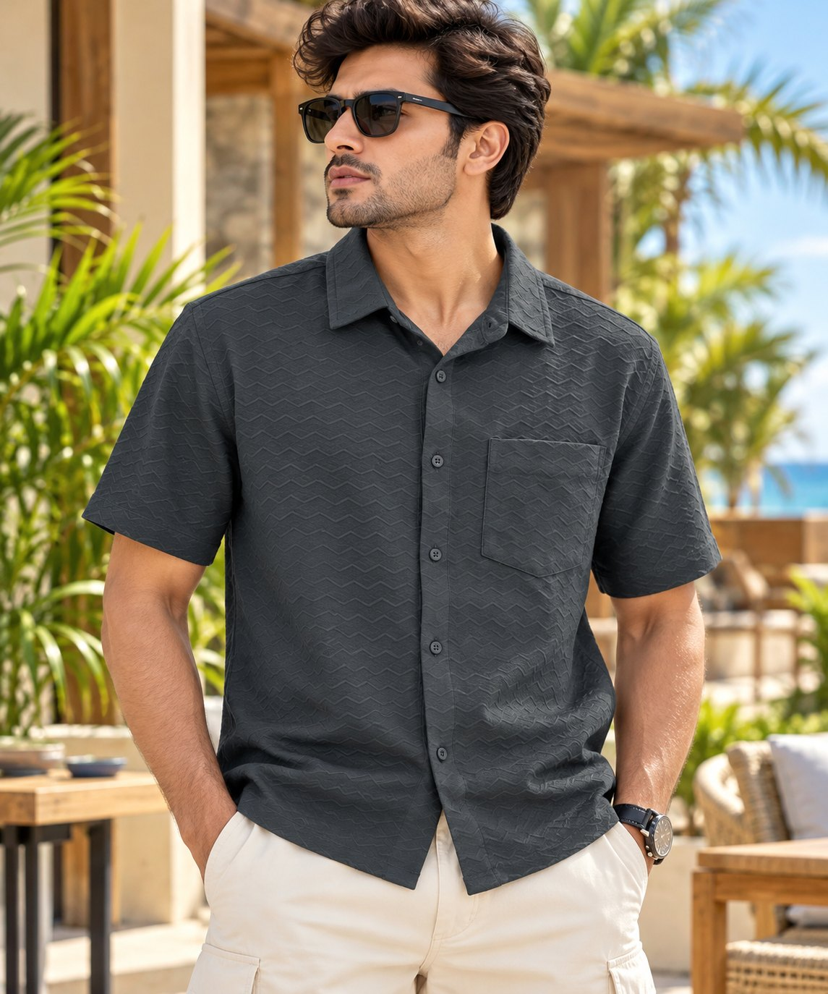
MENSWEAR PRODUCT QTY SHEET | STYLE 061
STYLE DETAILS
STYLE NO.
ODM/260528/0048 BLACK
SIZE-WISE QUANTITY (PCS)
SIZE | QTY (PCS)
XS
S
M
L
XL
XXL
TOTAL PCS
Image reference: outdoor_tropical_resort_style_portrait_scene_sunl.png • Enter style number and quantities in the blank fields

Slide 32
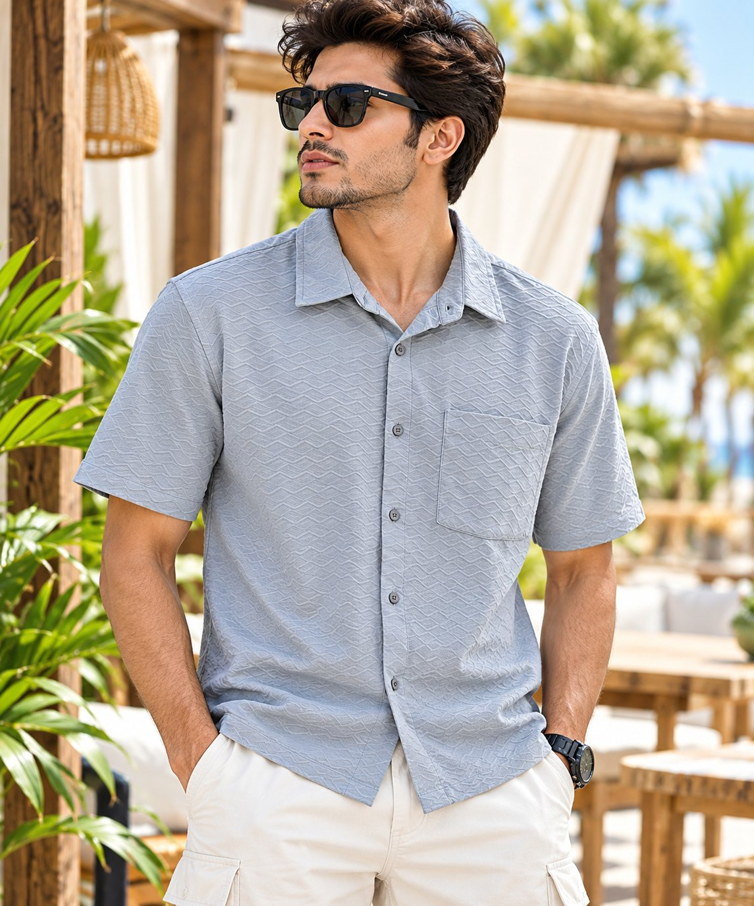
MENSWEAR PRODUCT QTY SHEET | STYLE 065
STYLE DETAILS
STYLE NO.
ODM/260528/0048 GREY
SIZE-WISE QUANTITY (PCS)
SIZE | QTY (PCS)
XS
S
M
L
XL
XXL
TOTAL PCS
Image reference: a_crisp_bright_outdoor_lifestyle_fashion_portrai.png • Enter style number and quantities in the blank fields

